Slide 1
A Glance of Major Cities in Canada
- A Tourist’s Point of View

Slide 2
Business Problem | Inspiration
As a tourist visiting Canada for the first time, the major cities Toronto, Vancouver and Ottawa are on my list.
While planning my trip, I want to learn about the cities on the high level so I know what to expect, and what to focus on in each city.
Downtowns: How similar/dissimilar are the downtowns?
Neighborhoods: What are the different neighborhoods in each city?
Food Selection: What are the most popular cuisines in each city?
To-do: What are the most popular recreational activities in each city?
Other: What are some of the unique characteristics of each city?

Slide 3
Business Problem | Generalization
Once packaged as a product, this can be a custom trip planning service
The customer can select the cities they want to visit (rather than most of the current travel sites that provide plans for only fixed combination of cities)
Rather than just giving out plans, compare and contrast the cities from various perspective to give travelers more background information. Travelers can then refine their plans to include/exclude, or increase/reduce time in certain cities based on what they see and what interest them
In each categories (such as food, culture, activities), customers can have an overview of what’s most popular and what’s most unique to each city, so that they can prioritize based on their own interests.

Slide 4
Data | What’s Needed
To Achieve this, the following data will be used
Data that contains the zip code and neighborhood information of Toronto, Vancouver, and Ottawa.
Latitude and Longitude information by zip code
Foursquare data that contains venue information in the 3 cities

Slide 5
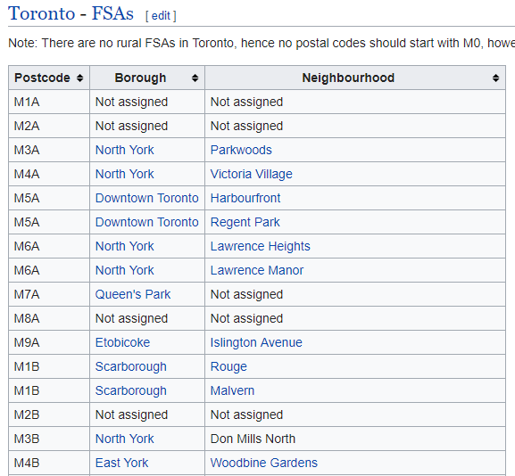
Data | Zip Code - Neighborhood
For Toronto, there’s a well-formatted data source that contains zip code – neighborhood information: https://en.wikipedia.org/wiki/List_of_postal_codes_of_Canada:_M
Some processing and cleansing is needed for missing data

Slide 6
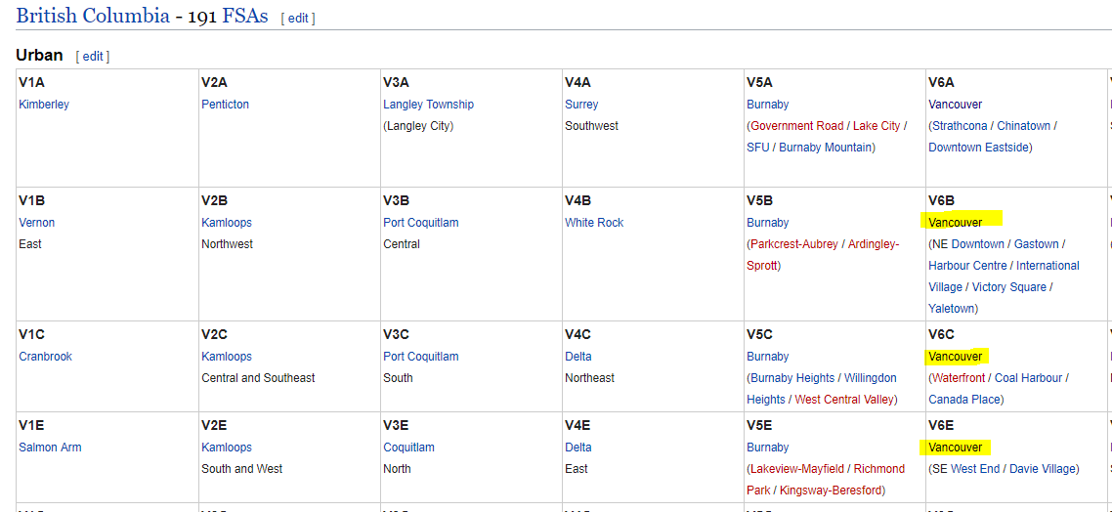
Data | Zip Code - Neighborhood
For Vancouver and Ottawa, more data processing is needed
Vancouver: https://en.wikipedia.org/wiki/List_of_postal_codes_of_Canada:_V
Ottawa: https://en.wikipedia.org/wiki/List_of_postal_codes_of_Canada:_K
Data is not organized in the format we need, some processing is required
Some cleansing is needed for missing data and irrelevant data (for the screenshot shown, need to limit to Vancouver data only)

Slide 7
Data | Coordinates
Coordinates information for each city can be found online: https://fusiontables.google.com/DataSource?docid=1H_cl-oyeG4FDwqJUTeI_aGKmmkJdPDzRNccp96M&hl=en_US&pli=1
We can filter the data by the first letter in the zip code (FSA-1) to download only data that’s relevant to this analysis.
The information will then be imported and combined with the neighborhood dataset in preparation for the next steps.

Slide 8
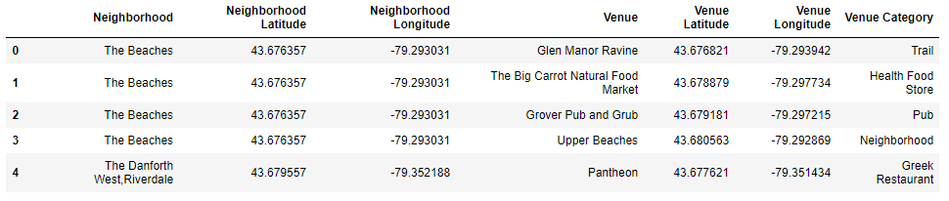
Data | Venue Information
Use Foursquare API to explore venues near each zip codes
Format of API is: https://api.foursquare.com/v2/venues/explore?client_id={}&client_secret={}&ll={},{}&v={}&radius={}&limit={}
Once data is obtained, a cluster analysis will be performed on neighborhoods, to find different neighborhoods in each city.

Slide 9
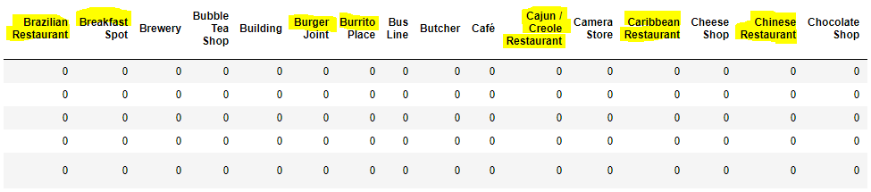
Data | Venue Information
For analysis on “food selection”, “to-do”, and “others”, realized the “category name” of venues are too detailed/granular for the purpose of this analysis
For example, restaurants/food is separated into cuisines and subtypes of cuisines; similar for other categories
A higher level grouping (Category Group) will be created
All the highlighted categories are food options, while the detailed breakdown is not necessary.

Slide 10
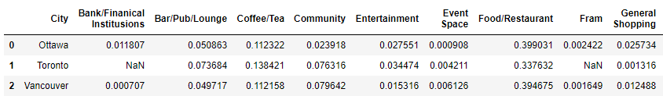
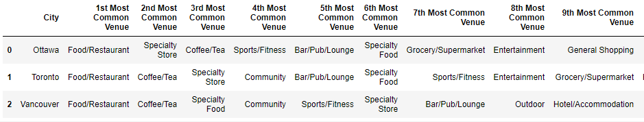
Observation | Overview of the Cities
For each city, analyses on the Category Groups’ frequencies and rankings for each will be performed
Category Group Frequency
Category Group Ranking

Slide 11
Observation | Overview of the Cities
From the analyses, we are able to get an overview of the cities:
Top 3 Venue Types (Category Groups)
No.1 Venue Type: For all 3 cities, Food/Restaurant is the most common venue type in the downtown area.
Other members in Top 3 Places: Coffee/Tea places are also among the top 3 venue types for all 3 cities. The remaining member in the top 3 places in both Ottawa and Vancouver is "Specialty Store", whereas in Vancouver "Specialty Food" made the 3rd place. This makes the density of food venues in downtown Vancouver the highest among the 3 cities.
Shopping
With "Specialty Store" being the no.2 venue type, and General Shopping (which primarily comprises of department stores, shopping malls & etc.), Ottawa appears to be the city that will be most attractive to shoppers.
Car Dependency
With a significantly higher density of public transportation facility (Category Group = Transportation), Ottawa is the least car dependent city, which usually means more flexibility and convenience to travelers.
Culture
Ottawa and Toronto have more Cultural venues with a combined Entertainment and Historic/Museum density of 5% (compared to 1.8% in Vancouver)
Outdoor
Vancouver has much more Outdoor activity options (5% venues being Outdoor compared to 2% in Toronto and only 1.2% in Ottawa).
Business
Vancouver has much higher density of Office spaces.
Vancouver also has the highest Event Spaces and Hotel/Accommodation venues, which makes it a place very suitable for conventions, exhibitions, and other events.
Other
Toronto may be a more comfortable and convenient city to live in with higher density of Service venues (salon, spa, auto shop, & etc.), and a good balance of other venues including public facilities (Category Group = Community), grocery store/supermarket, gym/fitness, and good amount of shopping and food selection in general. It also seems to be an interesting place to live in with its high density of bars, pubs, and coffee/tea places, and the good amount of cultural venues including museums and entertainment venues.

Slide 12
Observation | Neighborhood Clusters
We are going to look at what different neighborhoods there are in each city. Through this we will know what city functionality is in what relative location.
We will be using k-nearest neighbors (KNN) algorithm to cluster the neighborhoods based on the venue category groups that present in each of them.
For each city, we will group the neighborhoods into 4 clusters. For each cluster, we will compare and contrast the venue category group frequencies, top groups, and observe their location on a map.

Slide 13
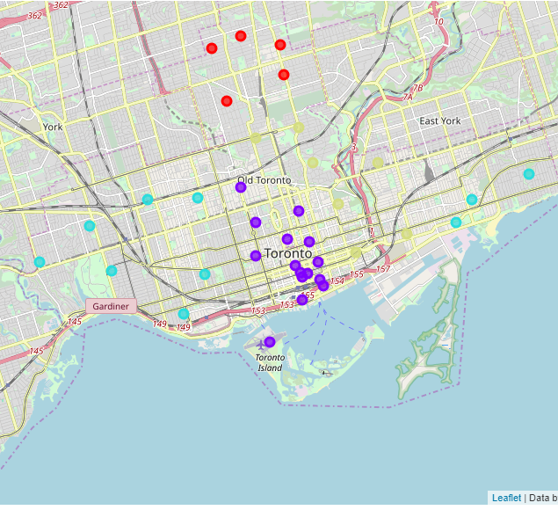
Observation | Toronto Neighborhood Clusters
Cluster 0: Residential (red)
Venues include Shopping, Pharmacy, Service, and a decent amount of Grocery/Supermarket, Outdoor, and Sports/Fitness (including gyms and studios) facilities
Cluster 1: Event/Tourism (purple)
High concentration of Event Space, Hotel/Accommodation, Transportation, Tourism, Entertainment, Sports/Fitness (including stadiums)
Cluster 2: Business/City Center (teal/blue)
High Concentration of Bar/Pub/Lounge, Food/Restaurant & Specialty Food. Office buildings are also found in this area, and it also has a decent amount of public facilities
Cluster 3: Culture/Education (lime/green)
Center of culture and education. Where you can find historic sites and museums, training and education institutions. There's also a decent amount of public facilities, entertainment, and hotel/accommodations.

Slide 14
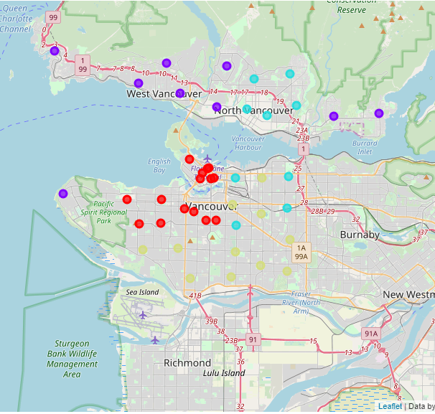
Observation | Vancouver Neighborhood Clusters
Cluster 0: City Center (red)
Center of entertainment and hotel/accommodation for the city, also has good amount of food selection including specialty food and general restaurant. Some training and education institution and outdoor facilities can also be found.
Cluster 1: Residential, Harbor, Tourism & Outdoor (purple)
Higher centration of banks, public facilities, general shopping, grocery store/supermarket and pharmacies make it convenient for residents. It has a good amount of office buildings, making commute easier for office workers.
Unlike residential areas in Toronto, this function area in Vancouver also has a good amount of outdoor facilities, tourism sites, historical sites and museums.
The harbor and public transportation facilities make it convenient for both residents and visitors.
Cluster 2: Culture & Entertainment (teal/blue)
This area is a good location for local cultural events and entertainment, with high concentration of bars, pubs, and lounges, decent entertainment, food venues, and historic sites/museums.
Cluster 3: Event & Entertainment (lime/green)
This is the event center for the city. It has the highest density of event spaces, great food selection including both general restaurants and specialty food, and decent entertainment options.

Slide 15
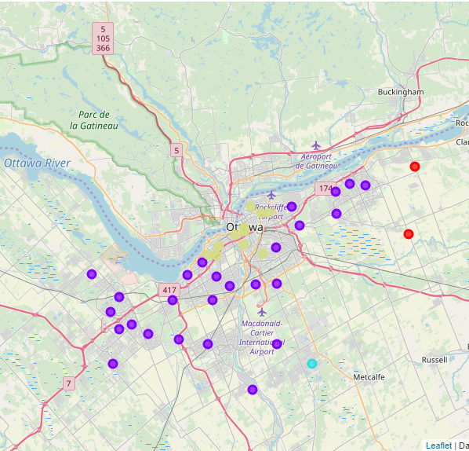
Observation | Ottawa Neighborhood Clusters
Cluster 0: Outer City (red)
Only two neighborhoods are categorized in this cluster. This cluster is primarily comprised of farms, historical sites and museums, transportation facilities, and sports facilities.
Cluster 1: Residential (purple)
This is the residential area with easy access to banks, entertainment, food and restaurant, shopping (general and specialty goods), grocery store and supermarket, pharmacies, service facilities, and gyms and fitness facilities.
There are also some office buildings which makes it convenient for commuters.
Cluster 2: Suburb (teal/blue)
Only one neighborhood (Greely) is in this cluster. Only four venues are found in this neighborhood, which is a zoo, a post office, a trailer park, and a bazaar. This is a suburban neighborhood.
Cluster 3: City Center (lime/green)
This is the city center with high concentration of bars, pubs, and lounges, entertainment, event spaces, great food selections including general restaurant and specialty stores, and hotels and accommodations.
This is also the center of public cultural functions including public service facilities, historical site and museums, and libraries.

Slide 16
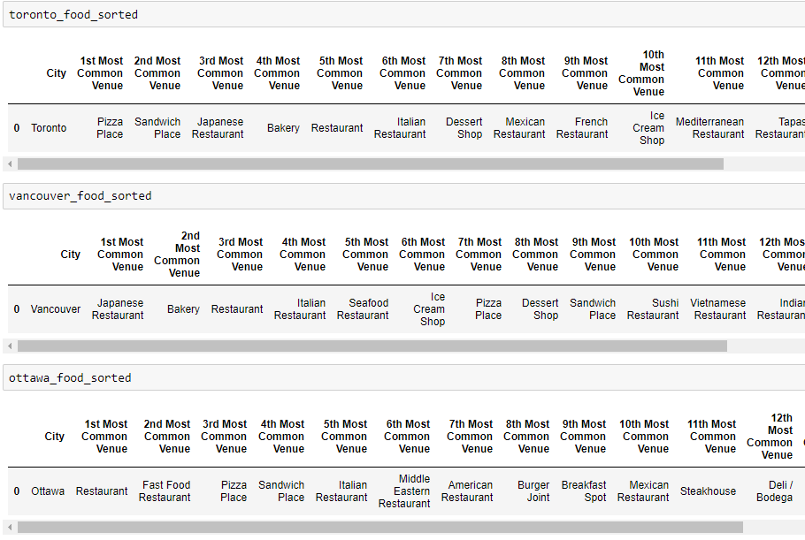
Observation | Food Selection Deep-Dive
From frequency and ranking analyses we have the following observation on food selection in each city:
Relative to the other two cities, Ottawa has less international food selections and more casual eating options (pizza, fast food, and sandwiches)
Toronto has more international food by having Japanese, Italian, Mexican, French, Mediterranean, and Spanish (Tapas) restaurants as top venues.
Vancouver has more Asian food by having Japanese, Vietnamese, and Indian restaurants in the top venue list.

Slide 17
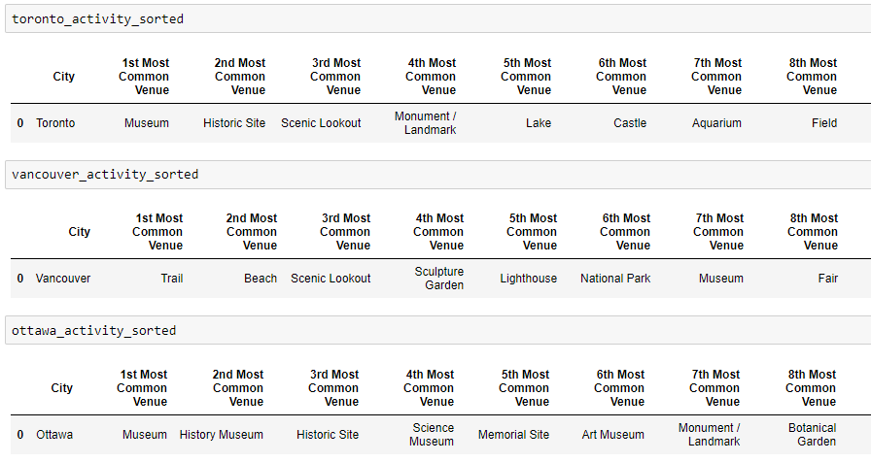
Observation | Activity Deep-Dive
From frequency and Ranking analyses we have the following observation on activity options in each city:
Ottawa has relatively limited outdoor activity options. There is ample amount of cultural activities in Ottawa such as museums, art, historical sites & etc.
There are plenty to look at in the city of Toronto, in addition to museums and historical sites like Ottawa, Toronto also has more varieties like Castles and Aquariums.
In Vancouver, visitors have many outdoor activity options. There are trails, beaches, scenic lookouts, national parks & etc. in Vancouver area.

Slide 18
Discussion
Venue data categorization
The current venue category values seem to be quite liberal, sometimes inaccurate categorization may happen. This is common in user-submitted data.
When the data volume is big (in big cities like Vancouver), usually it won’t affect the overall quality of the analyses too much. But if the data volume is limited (like the few suburban neighborhoods in Ottawa), a few mis-classification may have bigger impact on overall accuracy of analyses. In this case, more human intervention/review of the data will be needed.
Granularity of venue category data
As discussed in the Data section, the current “Venue Category” data from Foursquare API is too detailed and granular. This will post challenges in clustering analysis. In this project, a manual grouping of the Venue Category data is performed, and it greatly helped the effectiveness of the clustering algorithm (the clusters based on Category Groups are much cleaner and more explainable than those based on the raw Venue Categories).
If this analysis were to be generalized to be used on more cities, a better method to create the Category Group will be needed. This can be done through a few different ways:
Improvement of Foursquare data submission (make a mandatory Category Group field with pre-determined value selections upon venue creation)
A more intelligent algorithm to create the Category Group upon data processing. Regular Expression and/or other string analysis methods will need to be used.

Slide 19
Conclusion
Through the analyses of venues in the 3 major cities of Canada – Toronto, Vancouver, and Ottawa, we have gained knowledge of the similarities and dissimilarities of the cities.
Toronto is a very diversified city, it has many facilities that make it convenient and comfortable for residents to live in, and it also has many cultural and entertainment activities which makes it a very interesting place for tourists to visit.
Vancouver is a city with significant immigrant presence and it has great food selections. It has many outdoor attractions which makes it a wonderful destination for nature lovers. It is also a great city for conventions and events.
Ottawa as the capital of the country, it has many cultural and historical sites. The public transportation system is advanced here which makes it easy for visitors to get around. It is also a good place for shopping with a high concentration of department stores, shopping malls and specialty stores.
As a tourist, this project provided me with clear pictures of the unique characteristics of the 3 cities, and I now have a clear vision and expectation when I visit the cities.

